Slide 1
Officiating the high jump
Training for San Diego-Imperial
USATF Officials Association
by Kelly Smith 2024

Slide 2
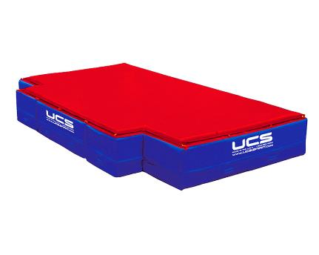
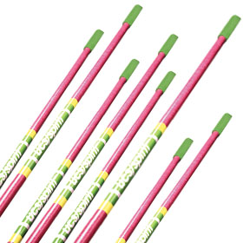
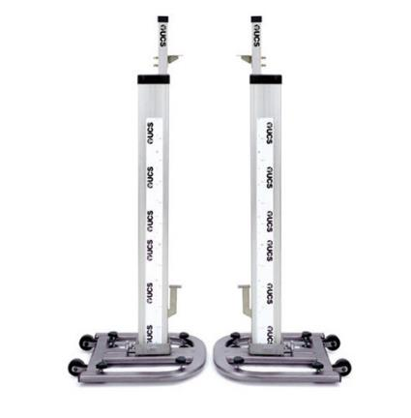
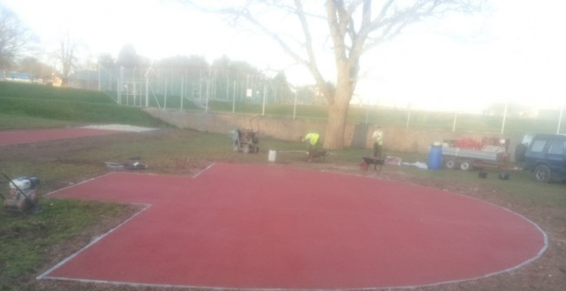
Officiating the high jump
High Jump Vocabulary
pit or landing area
crossbars
apron
uprights or
standards

Slide 3
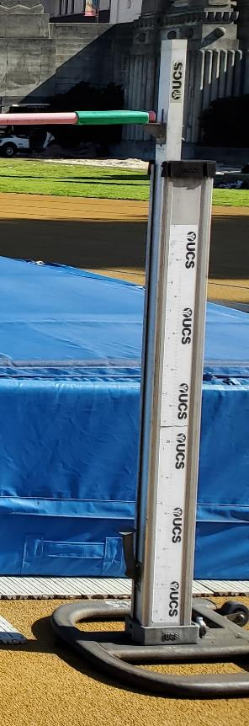
Officiating the high jump
High Jump Venue Set Up
Upright Placement
The uprights and landing area of the High Jump should be positioned such that there is a clearance of at least 10cm between them and the landing area when in use, to avoid accidental displacement of the crossbar by the movement of the landing area causing contact with the uprights.
USATF Rule Book 2023 – Rule 181.10 Note

Slide 4
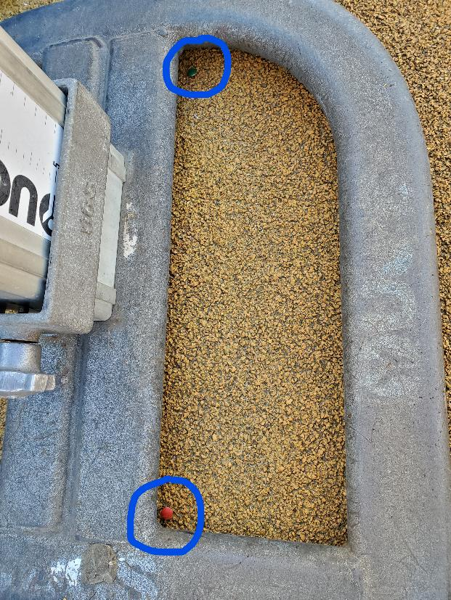
Officiating the high jump
High Jump Venue Set Up
Once the uprights have been positioned, place tacks in/around them so you know their exact position. Athletes measure their marks based on the position of the standards, so they should not be moved once positioned.
If an upright gets knocked over or shifts position during warm-ups or competition, it should always be moved back to its original position.

Slide 5
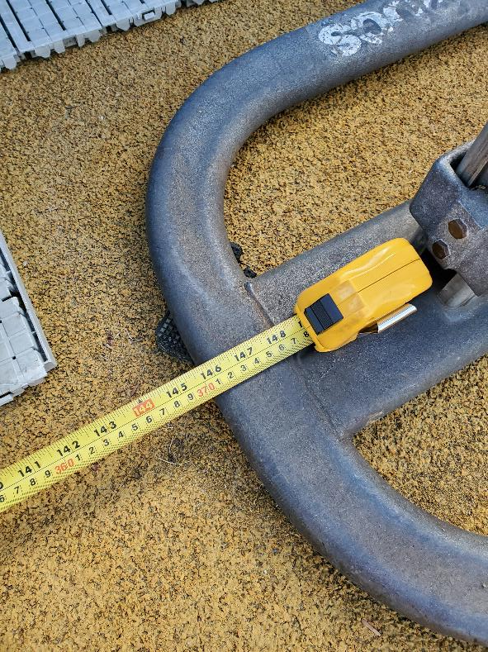
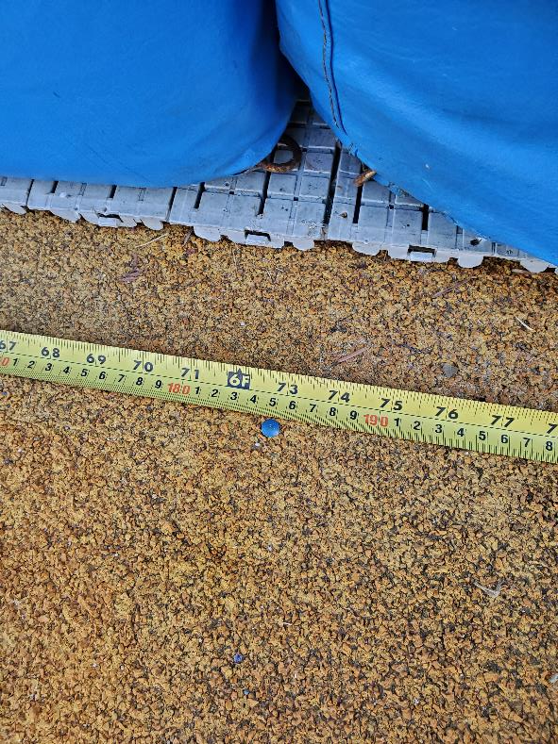
Officiating the high jump
High Jump Venue Set Up
Place measuring tape between the uprights to find the center point. Mark center point with a tack.

Slide 6
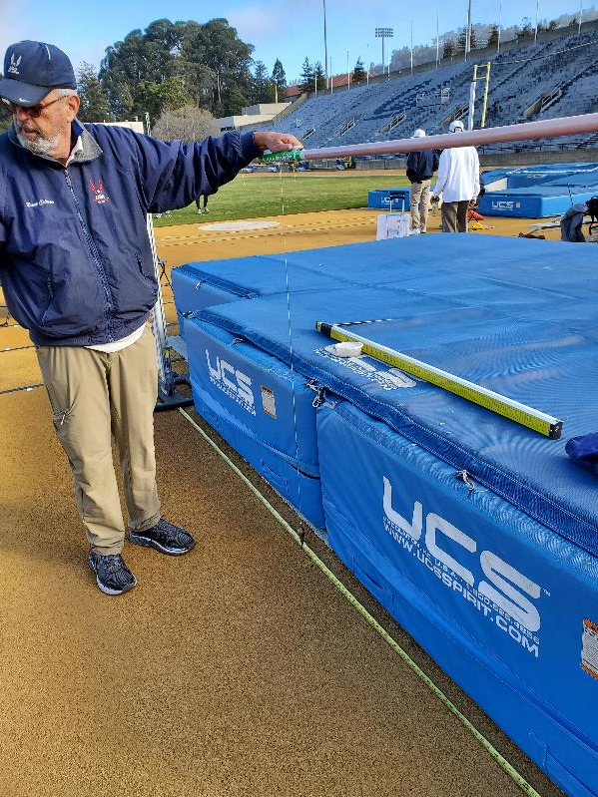
Officiating the high jump
High Jump Venue Set Up
Place a plumb bob at the front of the crossbar so that it aligns with the center tack. Then, mark the crossbar with a Sharpie pen to indicate the zero line. This is where you will measure the bar height.
Special thanks to Bob Coleman (pictured) of the Pacific Association for teaching me this.

Slide 7
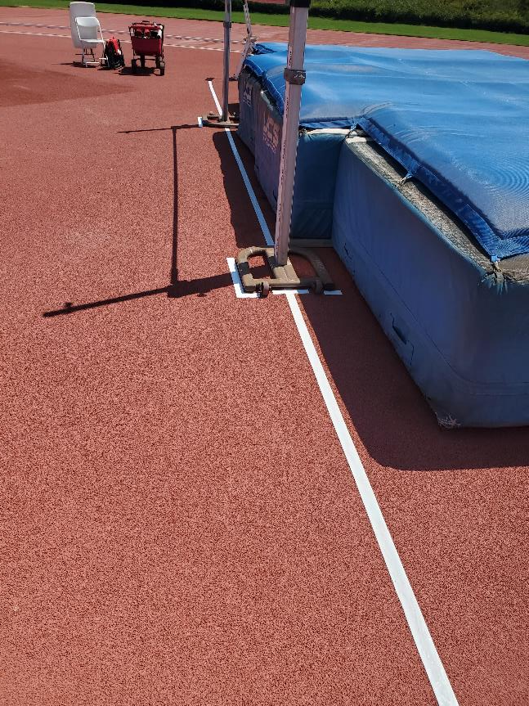
Officiating the high jump
High Jump Venue Set Up
Indicator Lines
A white line 50mm wide shall be drawn on the ground (usually with adhesive tape or similar material). The edge of the line nearest to the take-off area is drawn along the vertical plane through the edge of the crossbar nearest to the take-off area and extends for 3 meters on either side of the uprights.
USATF Rule Book 2023 – Rule 181.14 (a)
(Not done for NCAA or NFHS)

Slide 8
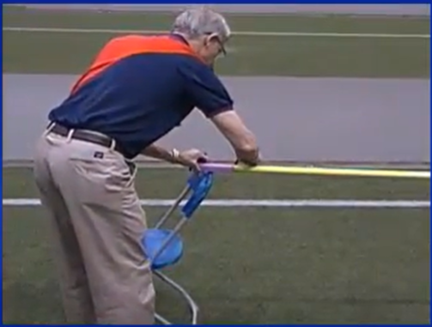
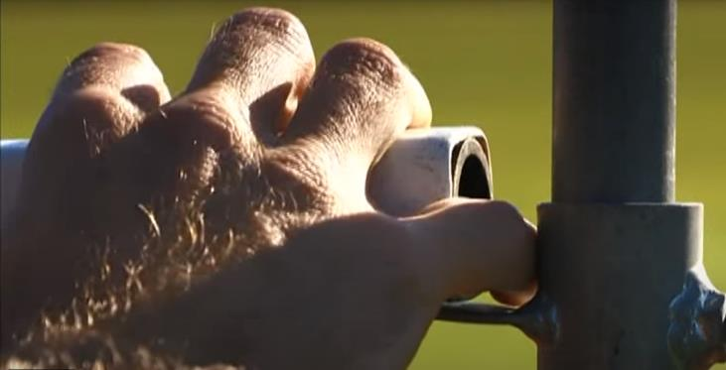
Officiating the high jump
High Jump Venue Set Up
Crossbar Preparation
Good video from USATF website
Crossbar Preparation for Vertical Jumps
Crossbar Placement
There shall be a space of at least 1cm
between the ends of the crossbar and
the uprights for the high jump.
USATF Rule Book 2023 – Rule 181.16

Slide 9
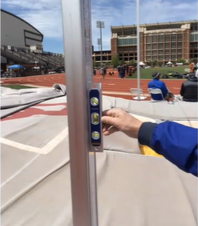
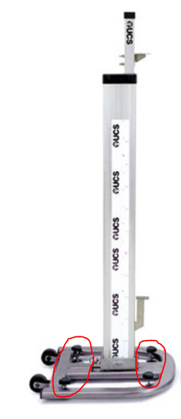
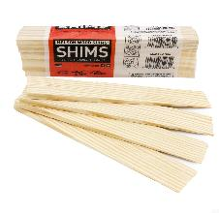
Officiating the high jump
High Jump Venue Set Up
Leveling Uprights
*Use a level to be sure the uprights are level.
*Use leveling screws at the base of the uprights or shims to make uprights stable.
*Uprights should not rock. They should be stable.

Slide 10
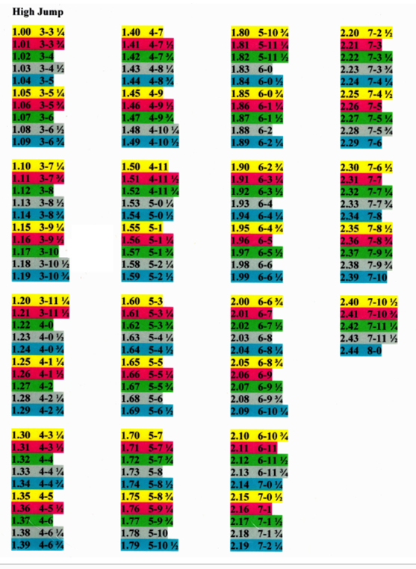
Officiating the high jump
High Jump Athlete Check-in
Check with Meet Management for initial height and subsequent heights.
(Minimum 2cm increments)
Ask athletes which height they would like to come in at and note it on the score sheet.
(Use a conversion chart if athletes do not
know the metric system.)

Slide 11
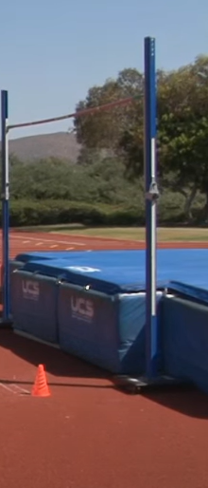
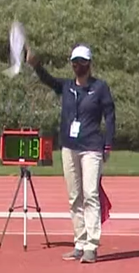
Officiating the high jump
High Jump Warm-ups
1. Keep an orange cone in front of the high jump pit until you are ready for athletes to do their warm-ups.
2. Determine and announce start and end times.
3. Stand in the middle of the apron with flags and direct traffic so that athletes do not crash into each other. Be sure that athletes approaching from both sides get an equal number of jumps. (Use white flag for side that is jumping & red flag for side that is waiting.)

Slide 12
Officiating the high jump
High Jump Competition
After the warm-up time is concluded, meet with the athletes in a circle to do the following:
review each athlete’s opening height
review the jumping order and how athletes will be called (up, on deck, on hold)
tell athletes about time limits and flags (yellow flag when 15 seconds left)
tell athletes to check out/in with you if they must leave for another event
have athletes show you their 1 or 2 tape markers on the apron (see tips & tricks)
tell athletes that they can meet with their coaches outside the competition area
tell athletes that it will be a safe and fair competition, wish them luck, & smile! ☺
Check the opening bar height with measuring tape or measuring stick.
Write the competition start time on the score sheet.

Slide 13
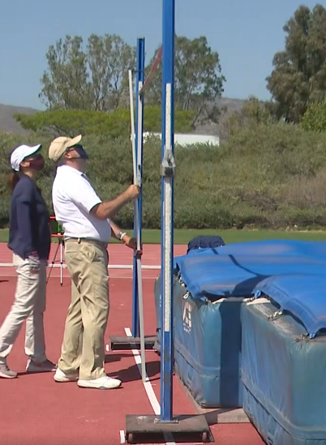
Officiating the high jump
High Jump Competition
Depending on the number of officials at the meet, you may have to do one or all of the following:
call up athletes for each attempt (up, on deck, on hold)
time each attempt (see next slide)
watch the plane (white line) of the uprights to be sure it is not crossed by any body part without first clearing the bar
watch that the athlete takes off from one foot
raise flags for:
time warnings (yellow)
failed attempts (red)
valid attempts (white)
mark the score sheet (X = failed attempt, O = valid trial, - = pass)
replace crossbar for missed attempts
measure the crossbar after every new height set
watch the position of the landing pit and move when necessary so that it doesn’t touch the uprights

Slide 14
Officiating the high jump
High Jump Competition
Timing & Bar Raise Increments
 | USATF | WA | NCAA | NFHS
4 or more Jumpers | 1 minute | 1 minute | 1 minute | 1 minute
2-3 Jumpers | 1.5 minutes | 1.5 minutes | 1.5 minutes | 3 minutes
1 Jumper | 3 minutes | 3 minutes | 3 minutes | 5 minutes
Consecutive Jumps (within height) | 2 minutes | 2 minutes | 2 minutes | 2 minutes
Bar Raise Increments | Minimum 2cm | Minimum 2cm | 3-5 cm | not stated
Time Expiration Warning → 15 seconds left → raise yellow flag slowly → at end, drop flag swiftly but with no sound
See rule books for combined events.

Slide 15
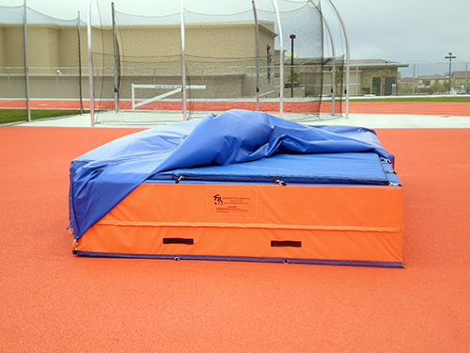
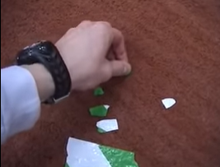
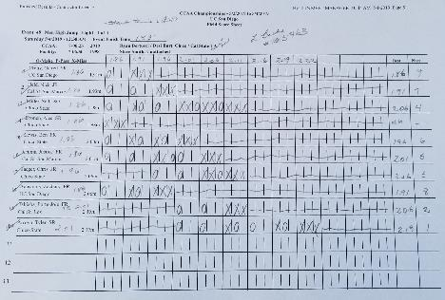
Officiating the high jump
High Jump After-Event Duties
Write the event ending time, your name,
and badge number on score sheet.
2. Lower uprights.
3. Put crossbar behind the pit.
4. Cover the pit and crossbars with the tarp.
5. Remove any tape or tacks on apron.
6. Return score sheet to Meet Management.

Slide 16
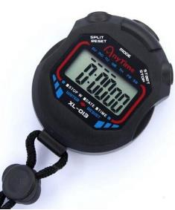
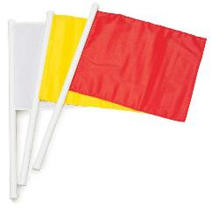
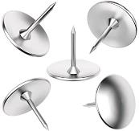
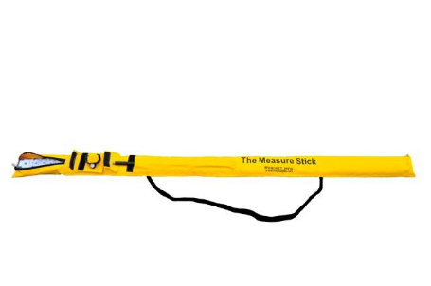
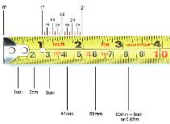
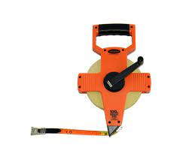
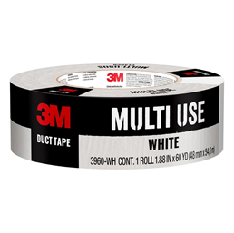
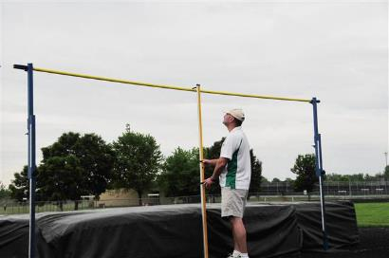
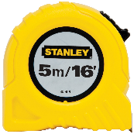
Officiating the high jump
High Jump Official’s Equipment Needed
stopwatch
measuring tools (tape/stick)
clipboard
pencils
pens
tacks
flags
rule book
white tape

Slide 17
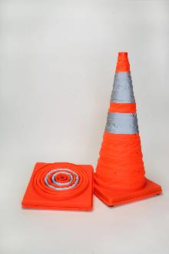
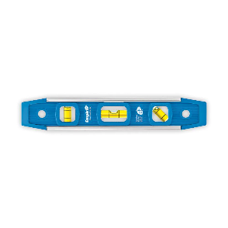
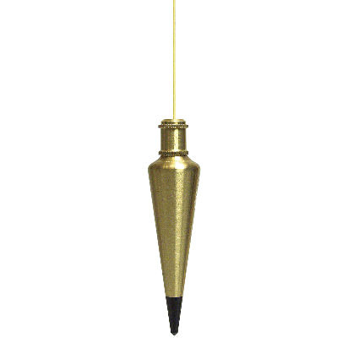
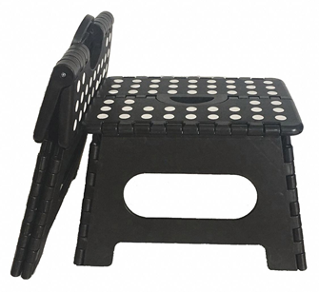
Officiating the high jump
High Jump Official’s Equipment Needed
cone(s)
shims
level
plumb bob
with string attached
step stool

Slide 18
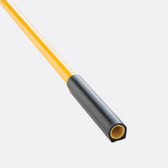
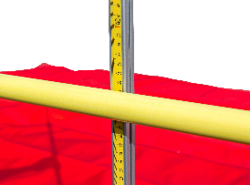
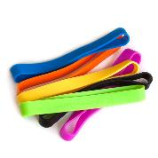
Officiating the high jump
Tricks of the Trade
*use your foot to move rubber crossbar ends down if stuck
*measure from behind the crossbar when using a measuring tape
*have coaches, parents, athletes help move the landing pit when it becomes displaced
*mark R or L next to the athlete’s name on the score sheet so you can remember which side he/she is jumping from
*give each athlete 2 stickers to place on their tape marks for easy identification of 2 marks per athlete – any tape mark without a sticker gets removed before competition
*use a thick elastic band around your clipboard to keep your score sheets/papers from blowing in the wind

Slide 19
Officiating the high jump
Other High Jump Resources
Zoom on One – High Jump - Jan. 31, 2023 Meeting Recording Access Passcode: .$HIFJ3N
(Start at 23:40)
Zoom on One - High Jump - Apr 13, 2021 Meeting Recording Access Passcode: t@03!rX.
High Jump Best Practices and Resources (updated 2023)
Vertical Events Preps & Problems 2019
High Jump Basics Explained - 2018
Venue Setup: The High Jump - 2014
Determining Places in Vertical Jumping Events - 2014
Conducting the Jump Off - 2014

Slide 20
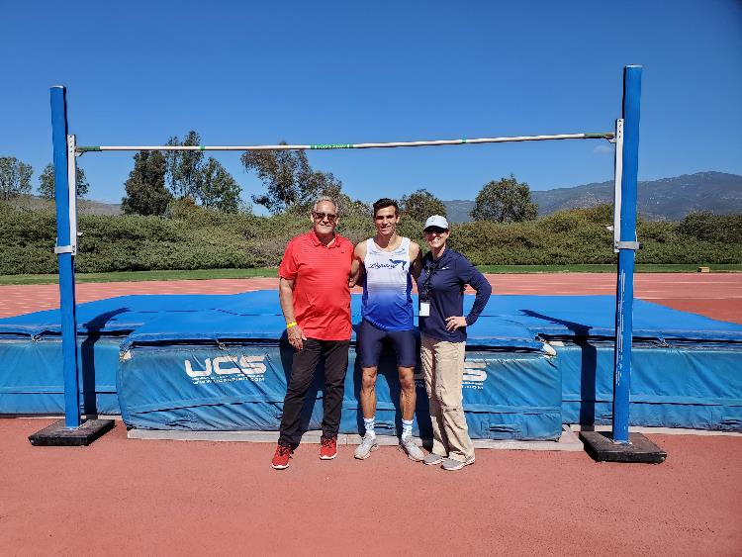
Officiating the high jump
High jumpers are wonderful athletes to work with,
and they appreciate your hard work.
Sign up to work the high jump!

