Slide 1
Fundamentals of Field Events: The Pole Vault
James Crow
National Official, Vertical Jumps
San Diego/Imperial Association

Slide 2
Outline
Overview of Pole Vault
Pole Vault Basic Rules
Time Limits for initiating an attempt
Definitions of Foul Attempts
Safety
Venue inspection and preparation
Procedures for conducting a safe competition
How to score a Pole Vault competition
Tie Breaking procedures
Jump-Off procedures
Notes:
High Jump and Pole Vault are known as the Vertical Jumps.
Many of the same rules apply to both so they are often combined as an area of officiating expertise. However, in practice, usually you end up having to choose one or the other because of time constraints.

Slide 3
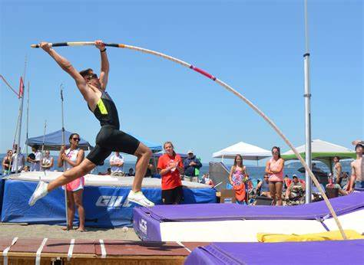
A proper set-up helps produce …
A safe competition
A legal competition
A fair competition
Notes:
A proper set-up helps produce:
A safe competition
A legal competition
A fair competition
Disclaimers:
Though most high jump officials will agree with what needs to be done to set up for competition, there are many ways to do the things we are going to talk about.
Each situation is different and the order of how you do these things may vary. In fact, some of things will be going on simultaneously as officials divide responsibilities.

Slide 4
Pole Vault Setup
Not all pole vault set-up is the same..
Much of this information comes from the USATF Officials Best Practices
Primarily from the Event Preparations – Pole Vault and the Zeroing PV Standards & Pit Set-up
Tools/Equipment
Beside the standard stuff (Flags, clipboards, rule books, pens/pencils, etc. you should also have
Stopwatch
Measuring device for height of pole (I purchased one) Can also use a painter’s roller attached to a long adjustable pole. Will have to do the actually measuring on the ground (Hopefully the venue will provide one for you)
WD-40 – to lube the standard if it is hard to move or turn the tightener on the height adjustment know
Tape – I use the white tape (show picture, but any type of duct tape will do)
Orange cone
50-meter-long measuring tape (to have as guide for athletes setting up their markers on the runway) Many Facilities now have distance marks next to the runway
Thumbtacks (for markers as well as holding down the measuring tape)
Markers for runway (I carry several different colors cut in the legal size (7x15 cm max) for athletes that do not have any or have illegal ones) Made from thin foam purchased at Michaels
Shims (either wood or plastic) (Can get at Lowe’s or Home Depot)
Plumb bob with string
Levels (both regular and one you can hang
Multi-tool/pliers
A Complete list can be found on the Event Preparations page for Pole Vault Best Practices

Slide 5
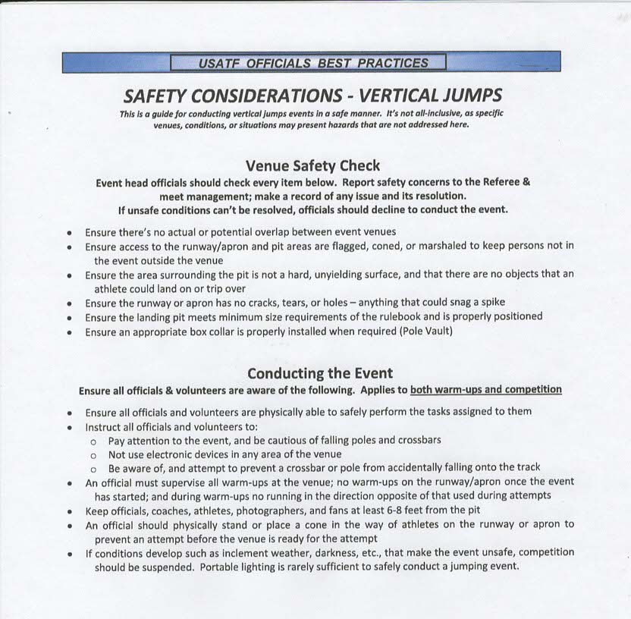

Slide 6
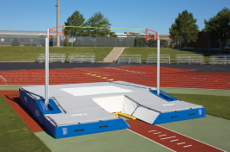
Pole Vault Venue Set Up
Cover hard surfaces such as concrete, metal, wood or asphalt with a minimum of 2 inches of dense foam or other suitable material
Remove movable objects such as hurdles

Slide 7
Anticipate Potential Problems from adjacent events
4 x 100m exchange zone
200m start

Slide 8
Inspect the Box & Landing Area
Check the area around the box
Remove debris & water from the box
Verify adequate clearance for poles to the pads
Verify that the pits are properly connected and the top cover is in place
Observe the condition of the pit
Verify the pegs are the proper length
55 mm for USATF & NCAA
76 mm for High School (3 inches)
Install extenders if necessary

Slide 9
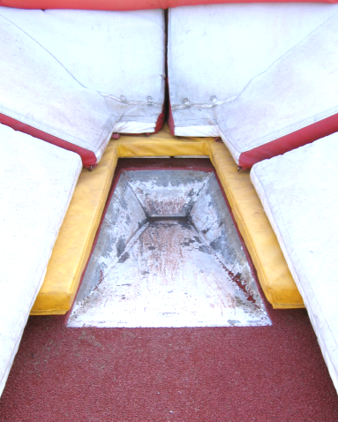
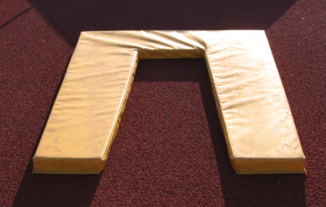
NCAA & high school competitions: verify there is a box collar
Changed for NCAA in 2014 and
Changed for NFHS in 2015
. . . See following slide . . .

Slide 10
Conducting a Competition
Read the rules the night before (from correct book)
Arrive early to allow time for venue set-up and warm-ups
Pole Vault: At least 2 hour before event start
warm-up start 1 hour before event
Pick up 2 copies of entry sheets
Make sure you have necessary equipment & helpers
Make sure the venue is safe
Have fun!

Slide 11
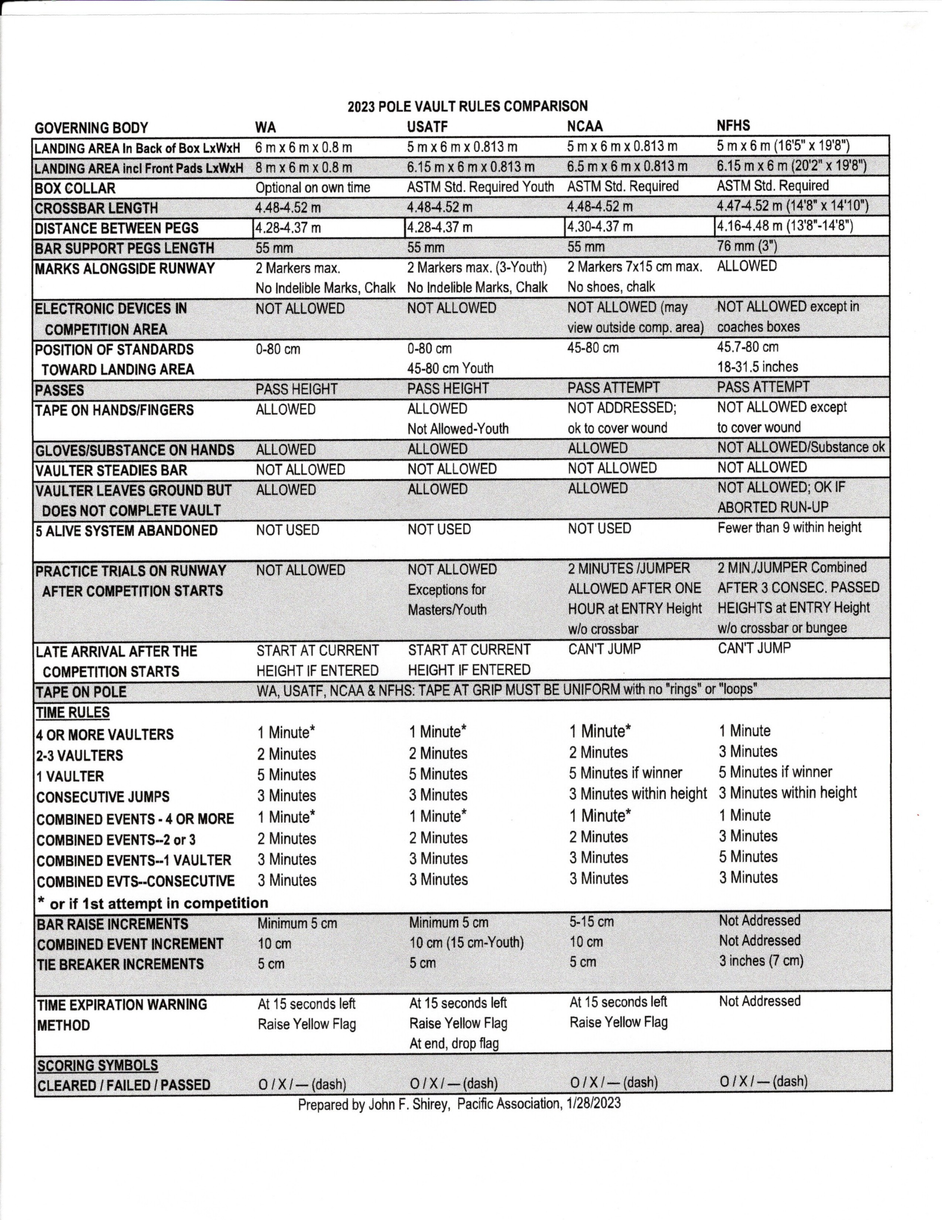
Rules Comparison Charts
in the Pole Vault are
VERY useful!
Tape one on the back of your event clipboard.
Courtesy of John Shirey
Pacific Association Master VJ
Who compiles the vertical jumps charts annually.

Slide 12
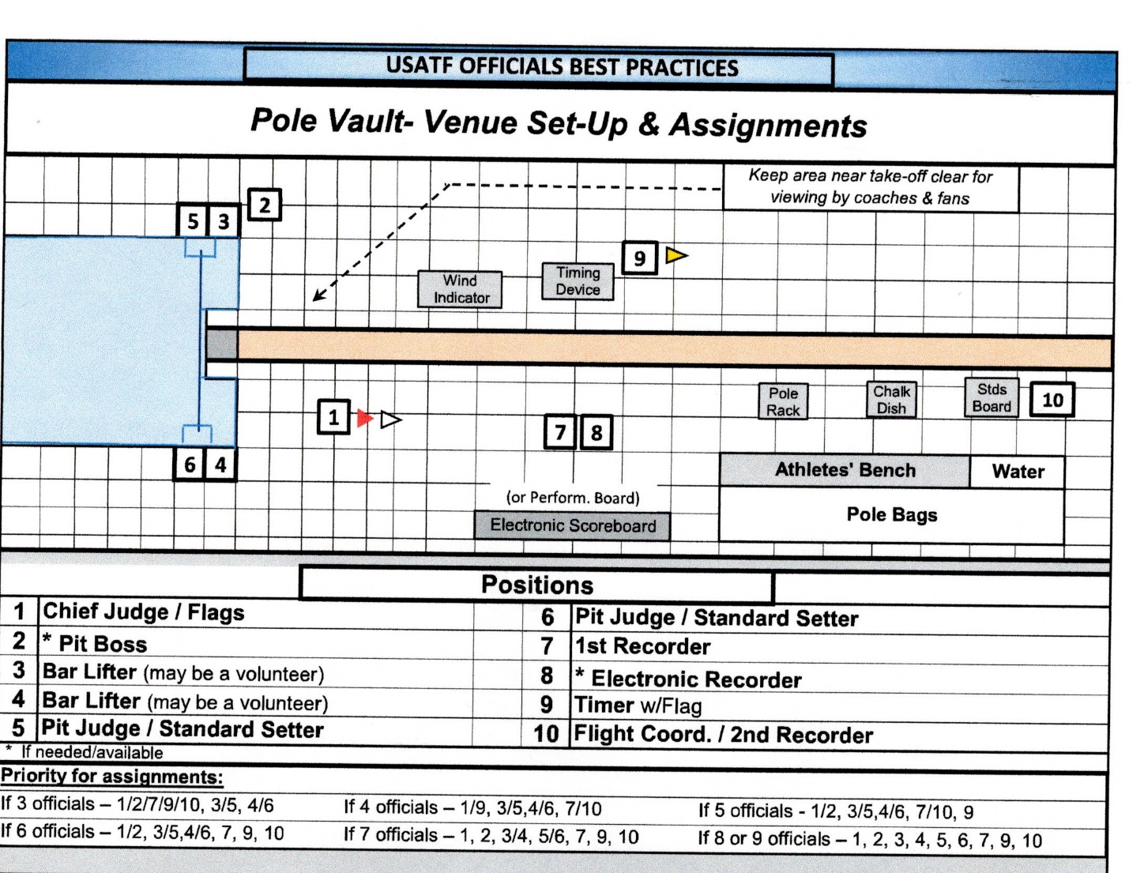
PV Officials Positions

Slide 13
Pole Vault Basics
 | Pole Vault
Crossbar Length | 4.48-4.52 meters (high school it is 4.47-4.52)
Number of Attempts | Unlimited until 3 misses in row
Opening height | Athlete’s choice
Height progression | Set by Games Committee
Height increments | IAAF/USATF | NCAA | High School
Open | Minimum 5 cm | 5-15 cm | Not addressed
Combined Events | 10 cm | 10 cm | Not addressed
Standards | IAAF/USATF | NCAA | High School
 | 0 – 80 cm | 45-80 cm | 45-80 cm
Passes | Pass height | Pass attempt | Pass attempt
Notes:
There are 4 different rule books with some differences.
Know which rule book is being used for your competition and use the correct rule.

Slide 14
Time Limits for Initiating an Attempt
 | Pole Vault
Time Limits (minutes) | IAAF/ USATF | NCAA | High School
> 4 or more vaulters | 1 | 1 | 1
2 – 3 vaulters | 2 | 2 | 3
1 vaulter | 5 | 5 (if Winner) | 5
Consecutive attempts | 3 | 3 (within Height) | 3 (within Height)
Warning: Raise yellow flag | 15 sec | 15 sec | No rule
NOTE: For Combined events the times are the same except for 1 it is 3 Minutes for IAFF/USATF and NCAA
Notes:
There are 4 different rule books with some differences.
Know which rule book is being used for your competition and use the correct rule.

Slide 15
It is a foul if …
When the crossbar is displaced in an attempt to clear it;
Exception: If, in the judgment of the official, the wind blew the pole into the crossbar causing it to fall.
When a competitor touches the ground or landing area beyond the plane of the crossbar or the crossbar extended without first clearing the bar.
It is not a foul if the athlete’s arm or pole breaks the plane without touching the ground or landing area beyond the plane.
If a competitor fails to initiate a trial within the time limit.
If, during or after the jump, the competitor deliberately steadies or replaces the bar.
If the pole is touched when it is falling toward the bar or uprights such that, without the intervention, the bar would have been knocked off.
If a competitor violates the warm-up restrictions.

Slide 16
It is a foul if … (cont.)
High School only:
If, after successfully clearing the bar, a competitor accidentally bumps the standards and displaces the bar while exiting the pit.
If the competitor uses a pole that is rated below his/her weight; the competitor will also be disqualified from the event.
If the competitor leaves the ground in an attempt and fails to clear the bar.
Exception: The competitor aborts the approach and in stopping plants the pole.
Note: It shall not be counted as a trial or failure if a competitor’s pole breaks during an attempt to clear the bar. The vaulter shall be awarded a new trial.

Slide 17
Scoring
X = Miss/Fail O = Cleared dash (-) = Pass
NCAA and High School: Record a “P” for each attempt that is passed.
Be sure to ask athlete if they are passing, the attempt or the height.
USATF - a pass is a pass of the height.
Places are determined by 1) fewest attempts at a height; 2) fewest total misses throughout the competition.
If the tie still remains for first place, the tying athletes must jump off.
 |  | Imper. |  |  |  |  |  |  |  |  |  |  |  |  |  |  |  |  |  | BEST MARK | Jumps Tied Ht | PLACE
Bib # | Name | Metric 3.30 |  |  | 3.45 |  |  | 3.60 |  |  | 3.70 |  |  | 3.80 |  |  | 3.90 |  |  |  | Total Misses
1 | Adams | P | P | P | X | O | - | P | P | P | O | - | - | X | X | X | - | - | - | 3.70 | 1 /1 | 3
2 | Bradley | O | - | - | X | O | - | X | O | - | X | X | X | - | - | - | - | - | - | 3.60 | 2 / 2 | 5
3 | Crane | P | P | P | P | P | P | P | P | P | X | X | O | X | O | - | X | X | X | 3.80 | - | 1
4 | Douglas | X | X | X | - | - | - | - | - | - | - | - | - | - | - | - | - | - | - | N/H | - | -
5 | Edwards | P | P | P | P | P | P | O | - | - | X | O | - | X | X | X | - | - | - | 3.70 | 2 / 1 | 4
6 | Graham | O | - | - | O | - | - | O | - | - | O | - | - | X | X | X | - | - | - | 3.70 | 1 / 0 | 2
7 | Howe | X | O | - | X | X | O | X | O | - | X | X | X | - | - | - | - | - | - | 3.60 | 2 / 4 | 6 Tie
8 | Irons | X | X | O | X | O | - | X | O | - | X | X | X | - | - | - | - | - | - | 3.60 | 2 / 4 | 6 Tie
9 | Jackson | O | - | - | X | O | - | X | X | O | X | X | X | - | - | - | - | - | - | 3.60 | 3 / 3 | 8

Slide 18
Jump Off Procedures
 | Pole Vault
 | IAAF/ USATF | NCAA | High School
Starting Height | Next ht. in progression above tie | Next ht. (cleared) in progression above tie | Lowest final failing ht.
Increment | 5 cm | 5 cm | 3 inches
High School Pole VaultExample
Athlete | Height and Performance |  |  |  |  |  | Total Fails | Jump Off |  |  | Place
 | 17’ 10” | 18’1” | 18’ 4” | 18’ 7” | 18’ 10” | 19’ 1”
 | 8’9” | 9’ | 6’ 2” | 6’ 4” | 6’ 6” | 6’ 8” |  | 19’ 1” | 18’ 10” | 19’1”
A | O | XO | O | XO | PPP | XXX | 2 | X | O | X | 2
B | XO | O | PPP | XO | PPP | XXX | 2 | X | O | O | 1
C | PPP | XO | XO | XO | PPP | XXX | 3 |  |  |  | 3
NCAA, USATF and IAAF High Jump Example
Athlete | Height and Performance |  |  |  |  |  | Total Fails | Jump Off |  |  | Place
 | 1.75 | 1.80 | 1.83 | 1.86 | 1.89 | 1.91 |  | 1.89 | 1.86 | 1.89
A | O | XO | O | XO | P | XXX | 2 | X | O | X | 2
B | XO | O | P | XO | P | XXX | 2 | X | O | O | 1
C | P | XO | XO | XO | P | XXX | 3 |  |  |  | 3

Slide 19
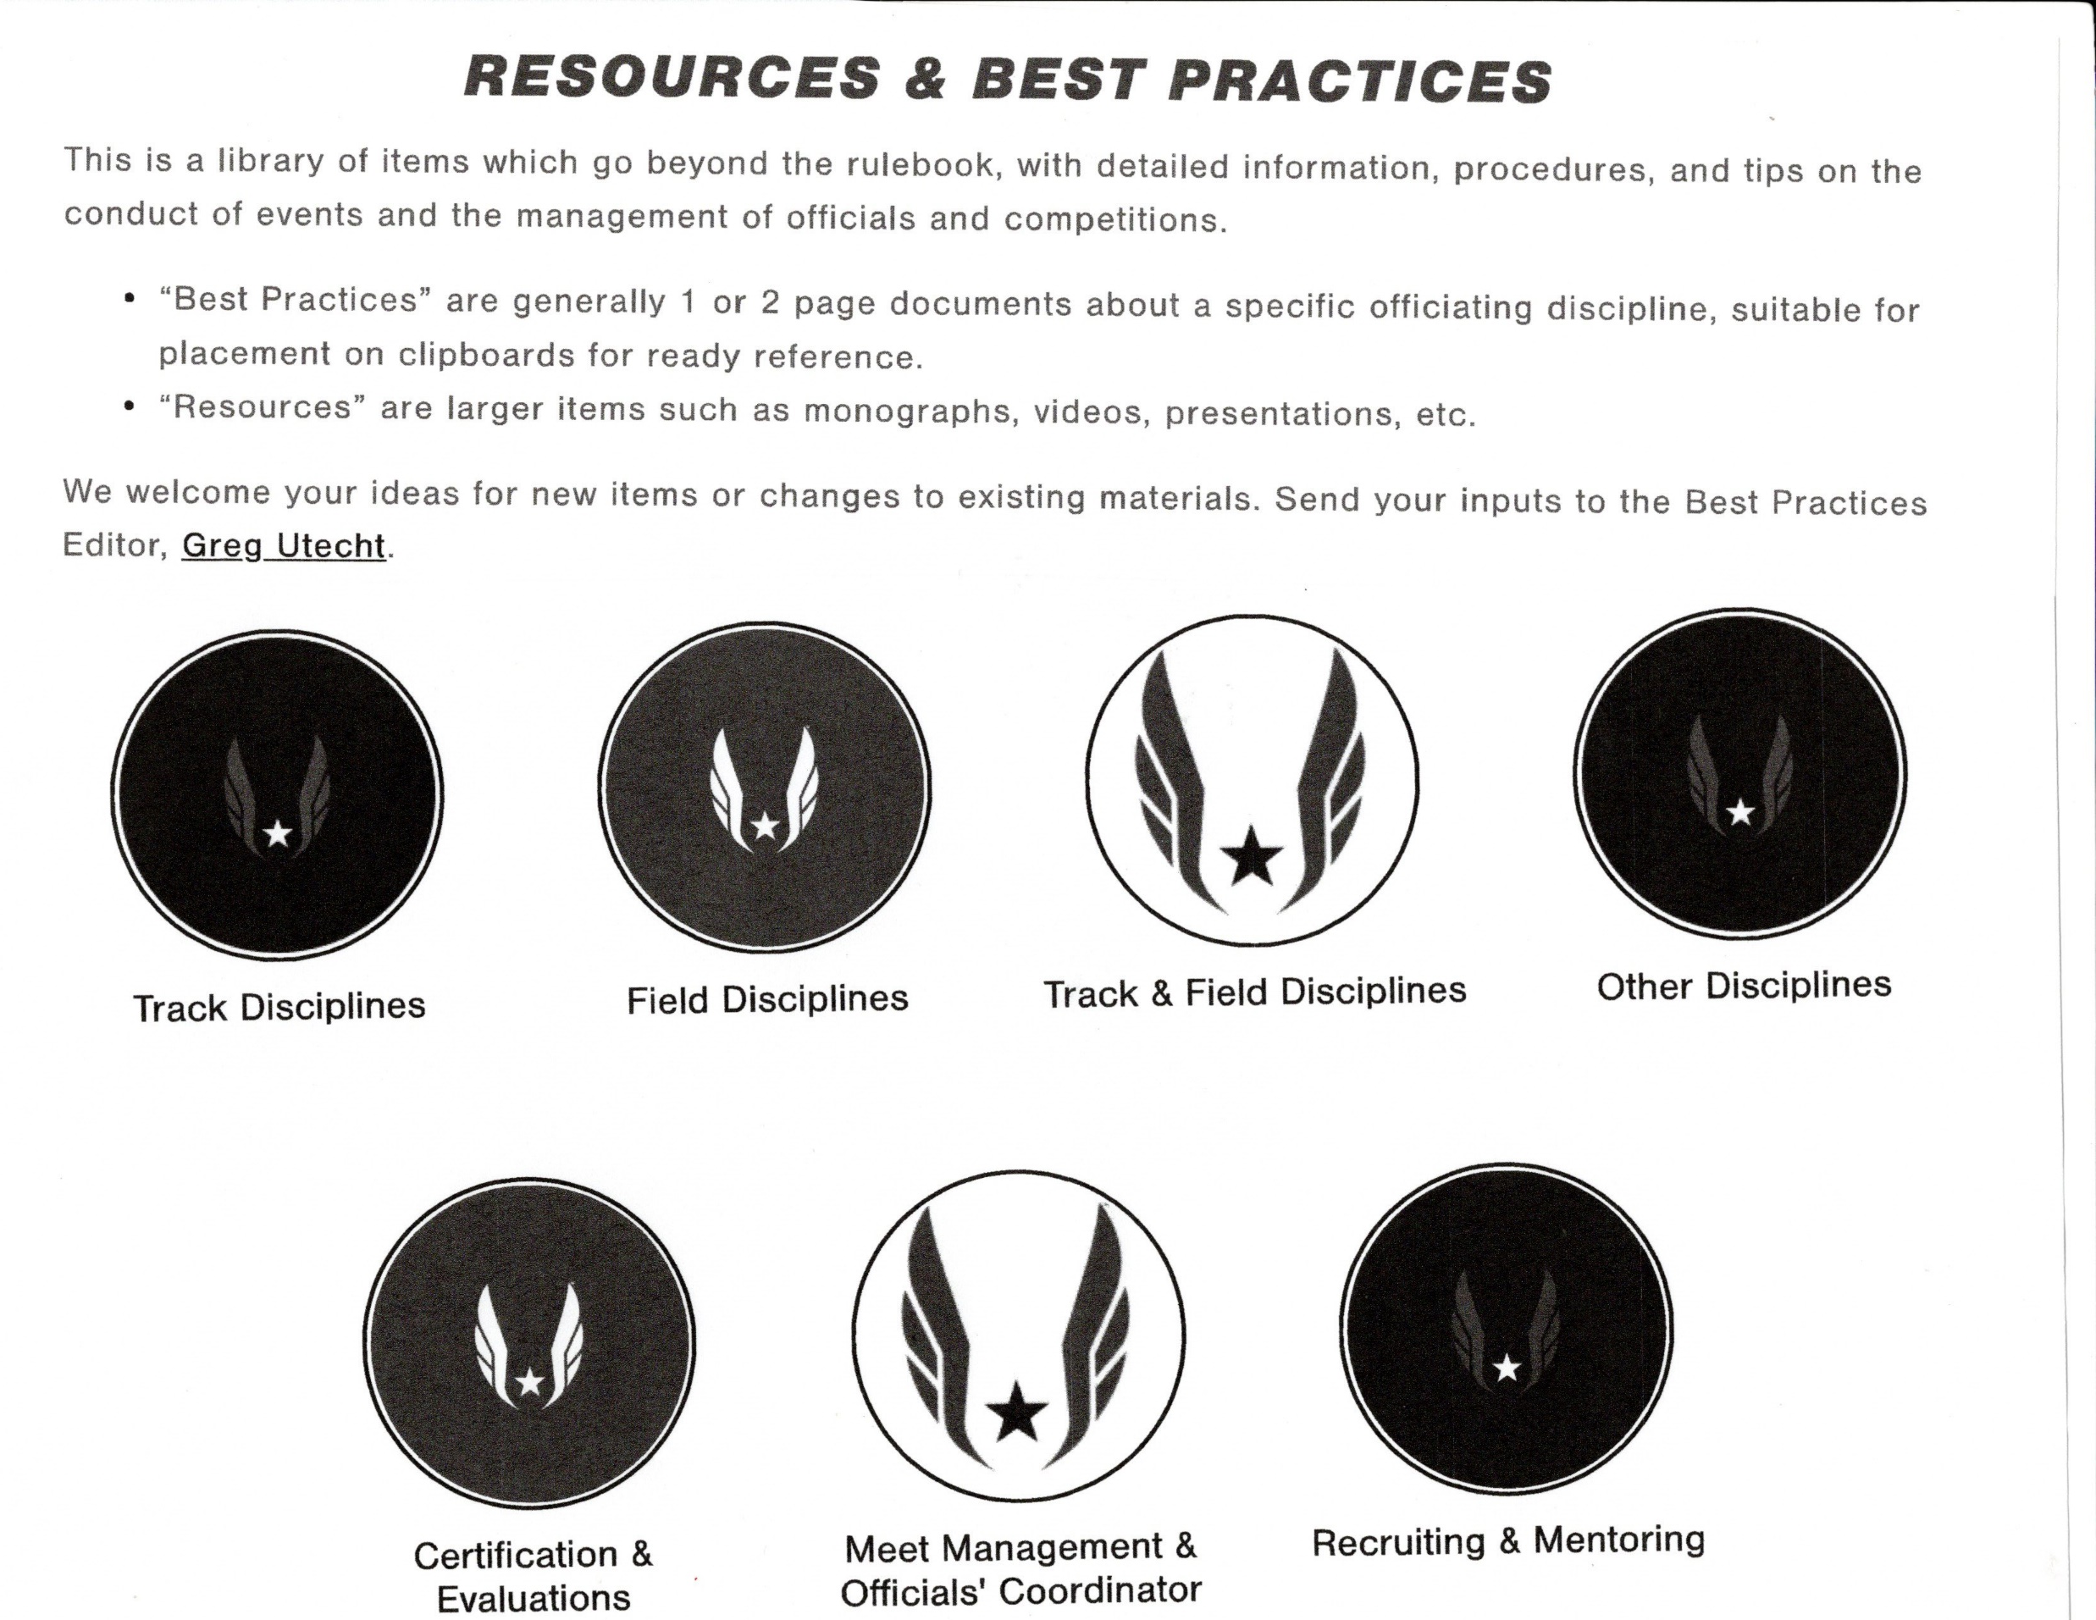
Best Practices www.usatf.org/groups/officials/resources/best-practices/

Slide 20
